Slide 1

Node.js Express Apps
Here We Go!
By: Chen Sovanminea

Slide 2



01
What is Express?

Slide 3
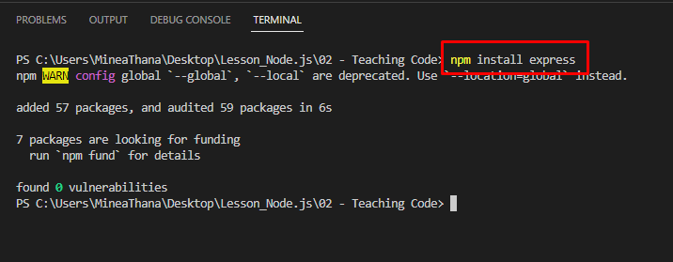
Express គឺជា Framework របស់ nodejs ដែលប្រើសម្រាប់ manage route, request, server-side logic និង​ response បានយ៉ាងងាយស្រួល ។
ដើម្បីអាចប្រើ Express បានជាដំបូងយើងត្រូវដំឡើង package វាជាមុនសិន ‘npm install express’។

Slide 4
02
Creating an Express App

Slide 5

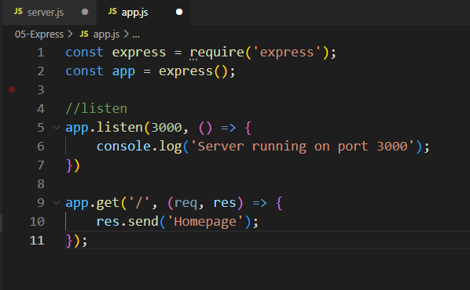
Create an Express
Require Express package
app.get() → HTTP GET method
req → request object
res → response object
Start a server with http://localhost:3000/

Slide 6
03
Return JSON Data

Slide 7
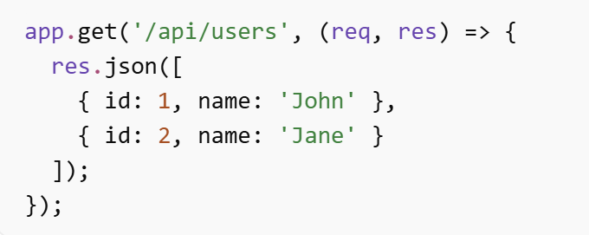
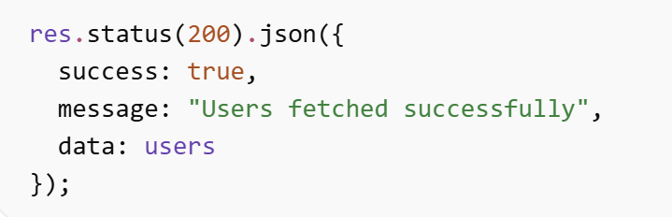
Create an Express
When use res.json(data):
Express Converts JavaScript object → JSON string
Sends response to client
For API → Use res.json()
APIs usually return JSON:
res.json() automatically sets Content-Type to application/json

Slide 8
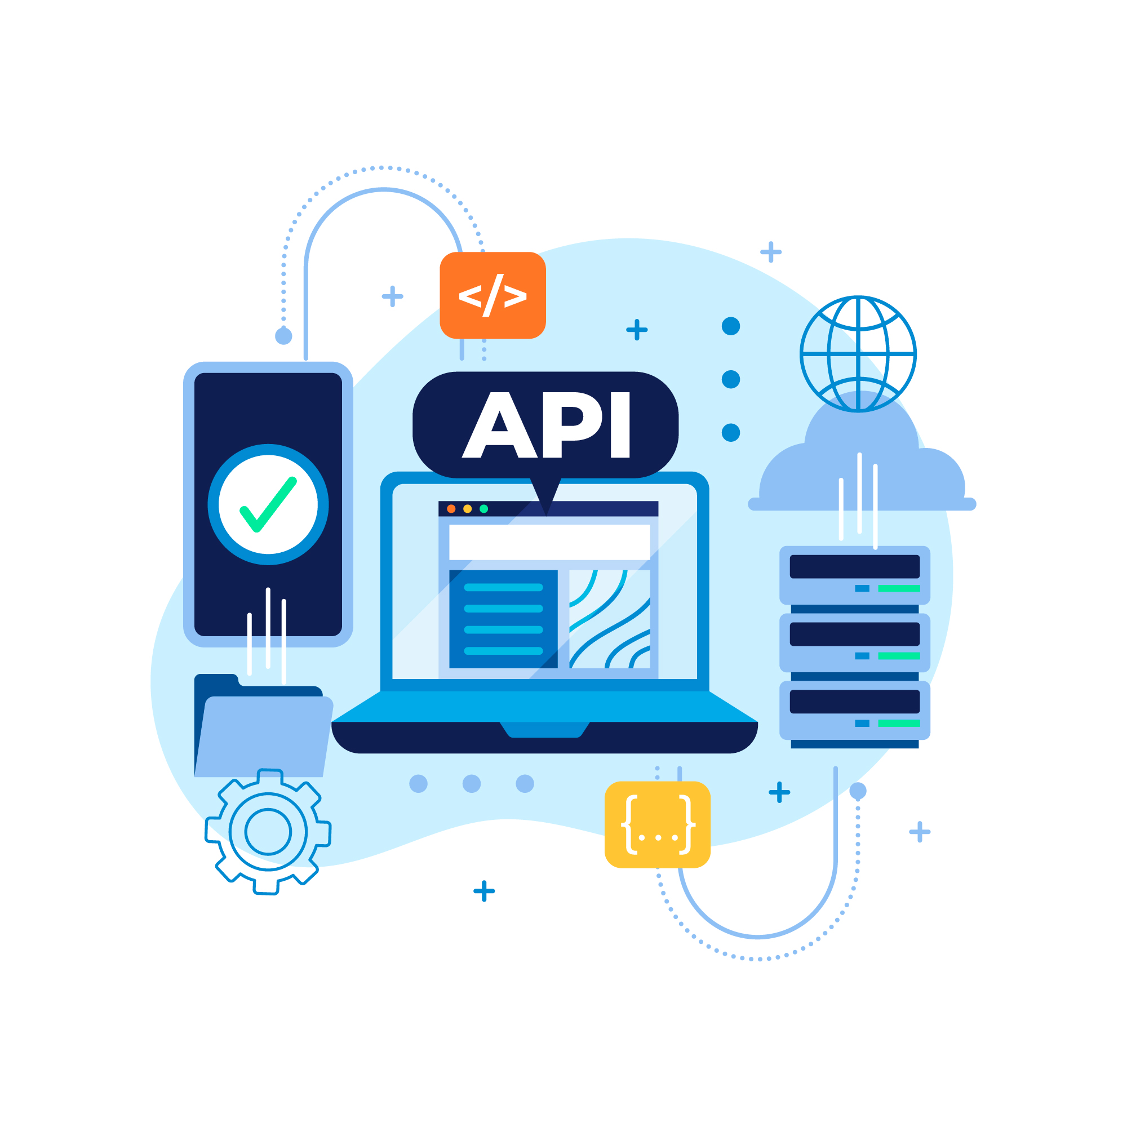
Summary
API does NOT return HTML
API does NOT render page
API returns DATA only
Frontend decides how to display data

Slide 9

Thanks you

